Slide 1

Slides for Courses Using the Business Intelligence Guidebook
From Data Integration to Analytics
by
Rick Sherman
www.biguidebook.com

Slide 2

Business Intelligence Guidebook – From Data Integration to Analytics
www.biguidebook.com
November 2014
Imprint: Morgan Kaufmann
Print Book ISBN : 9780124114616
eBook ISBN : 9780124115286

Slide 3
Chapter 13: Business Intelligence Application Chapter 14: BI Design and Development

Slide 4
Chapter 13 Business Intelligence Applications

Slide 5
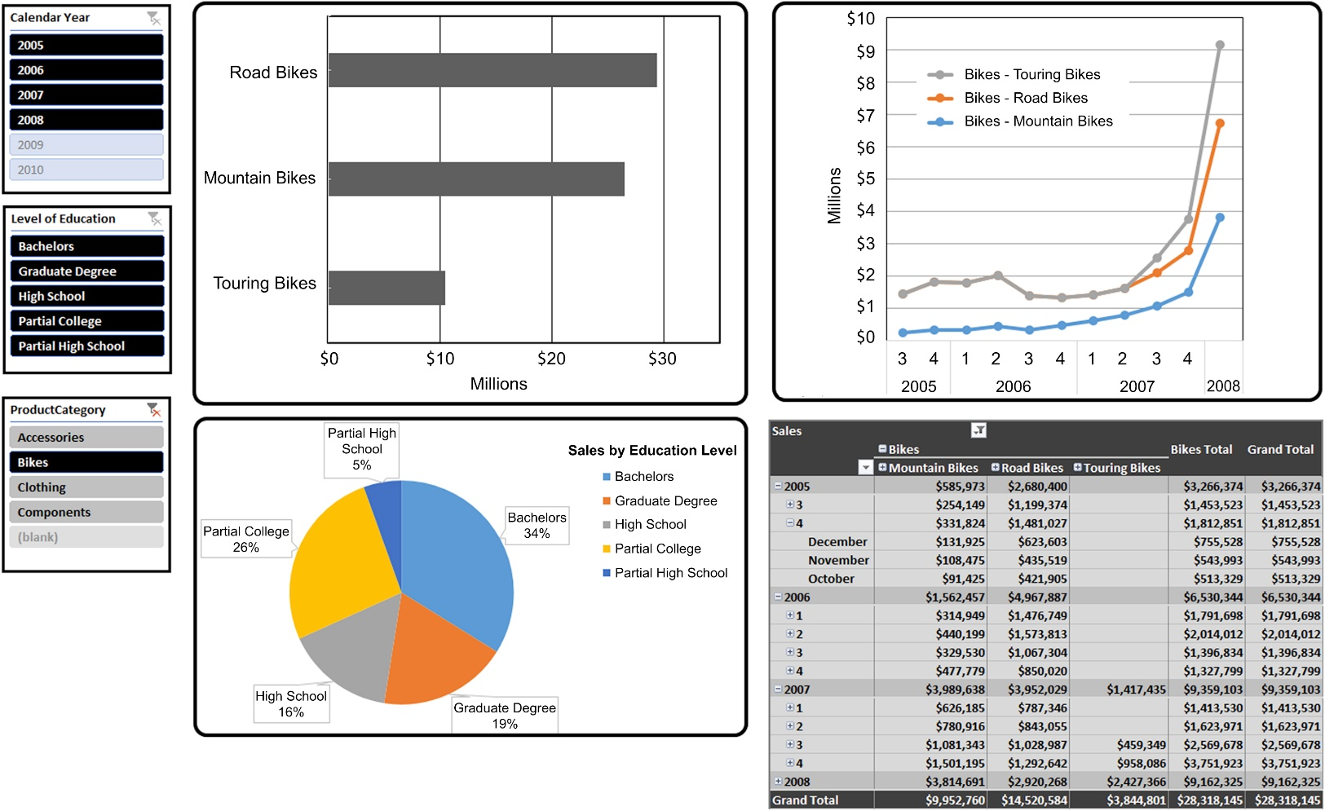
Dashboard example 1
f13-01

Slide 6
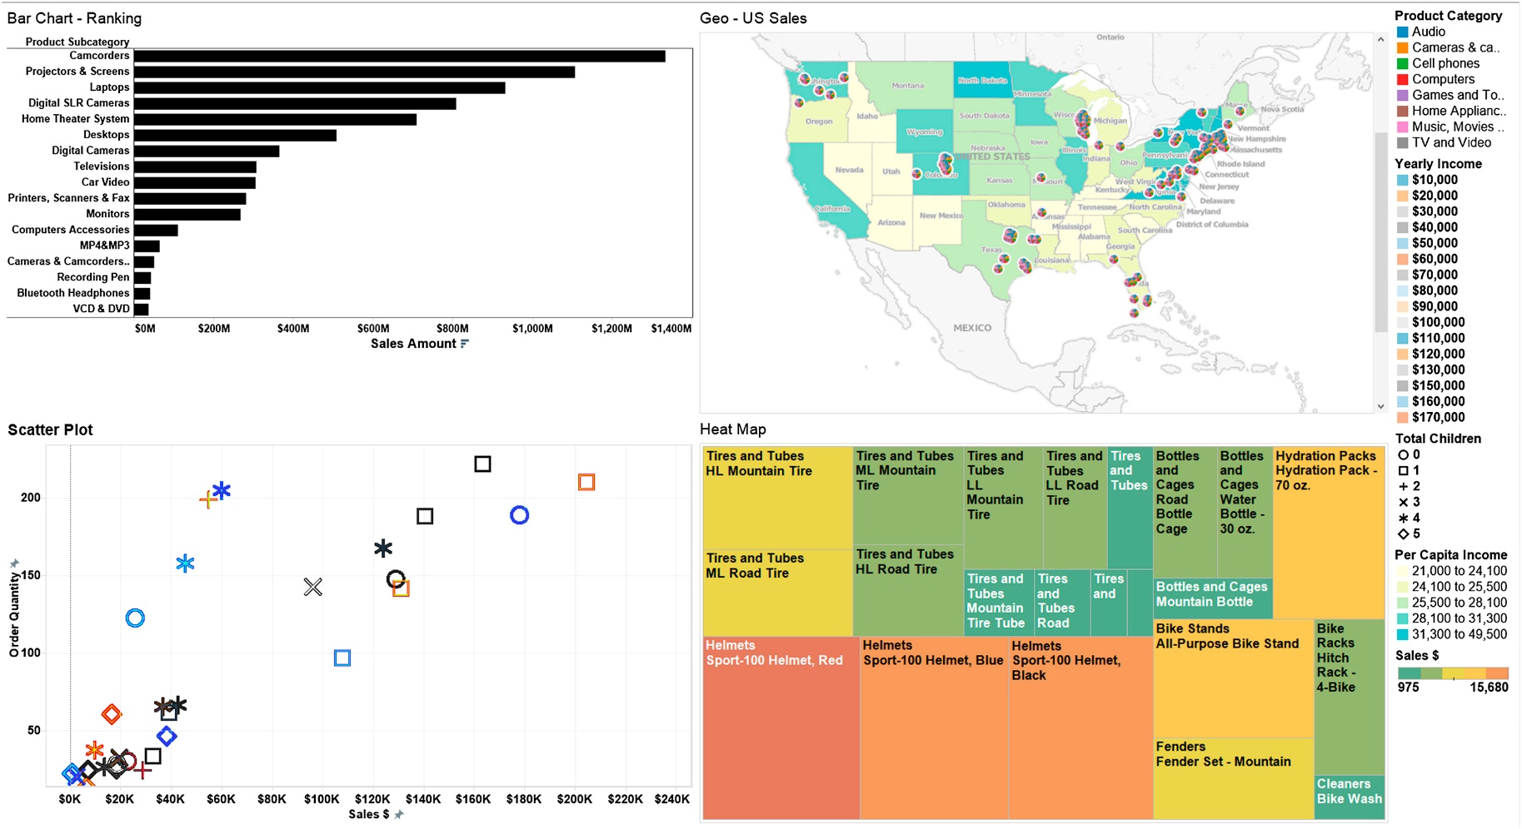
Dashboard example 2
f13-02

Slide 7
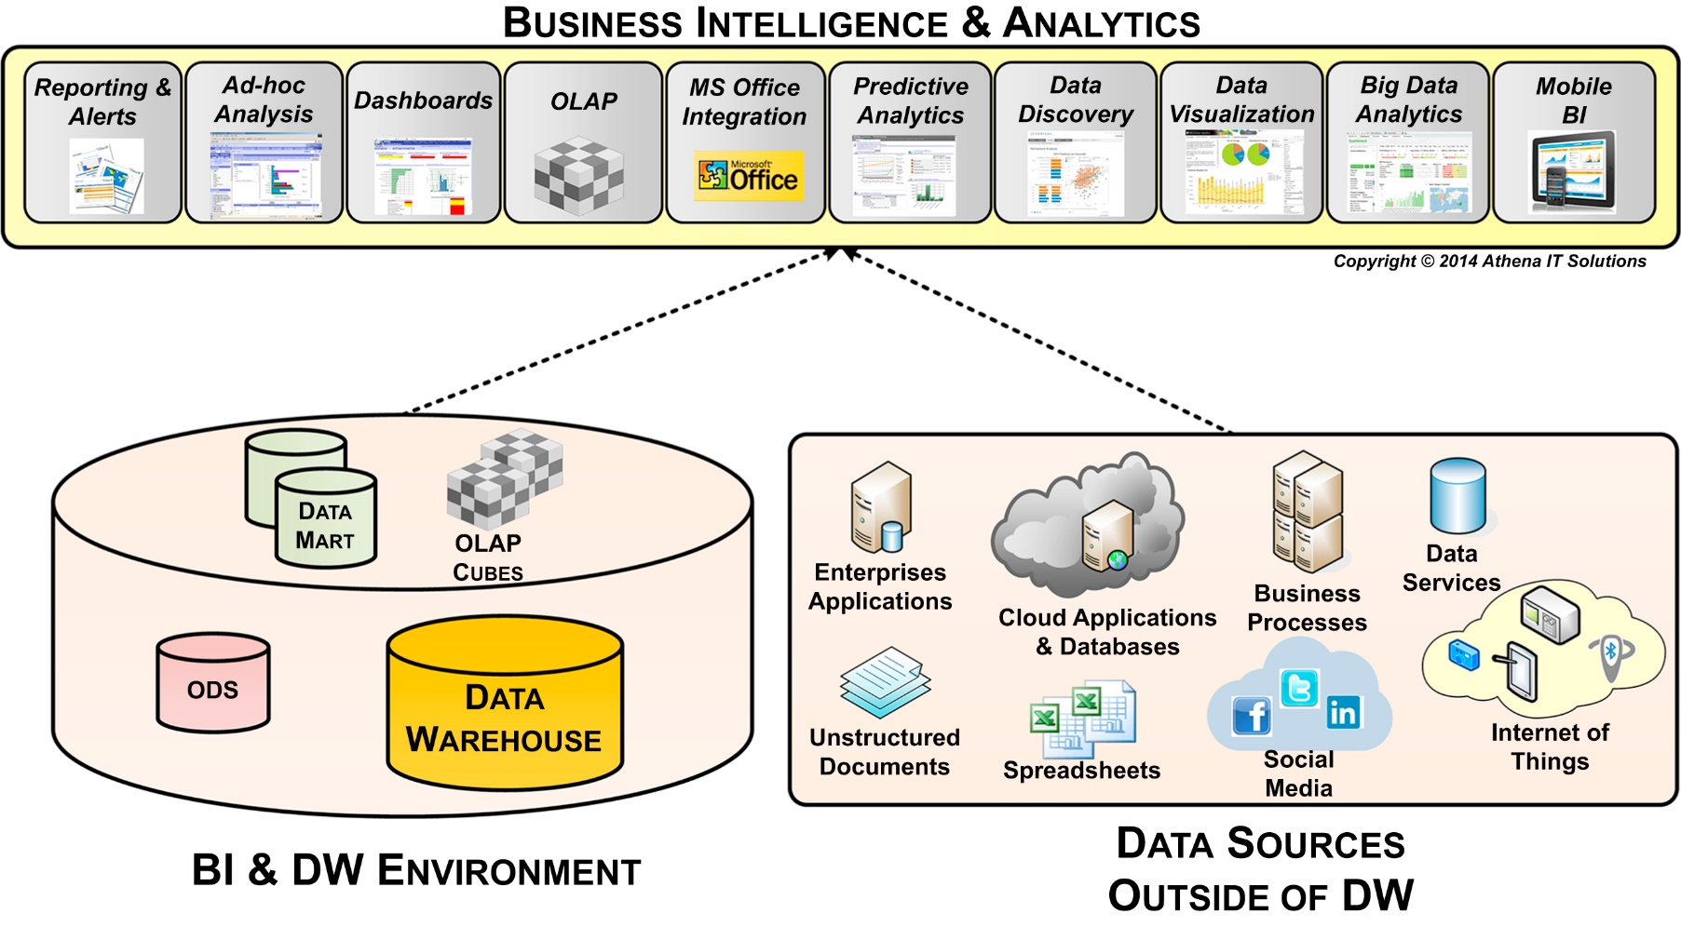
BI data sources
f13-03

Slide 8
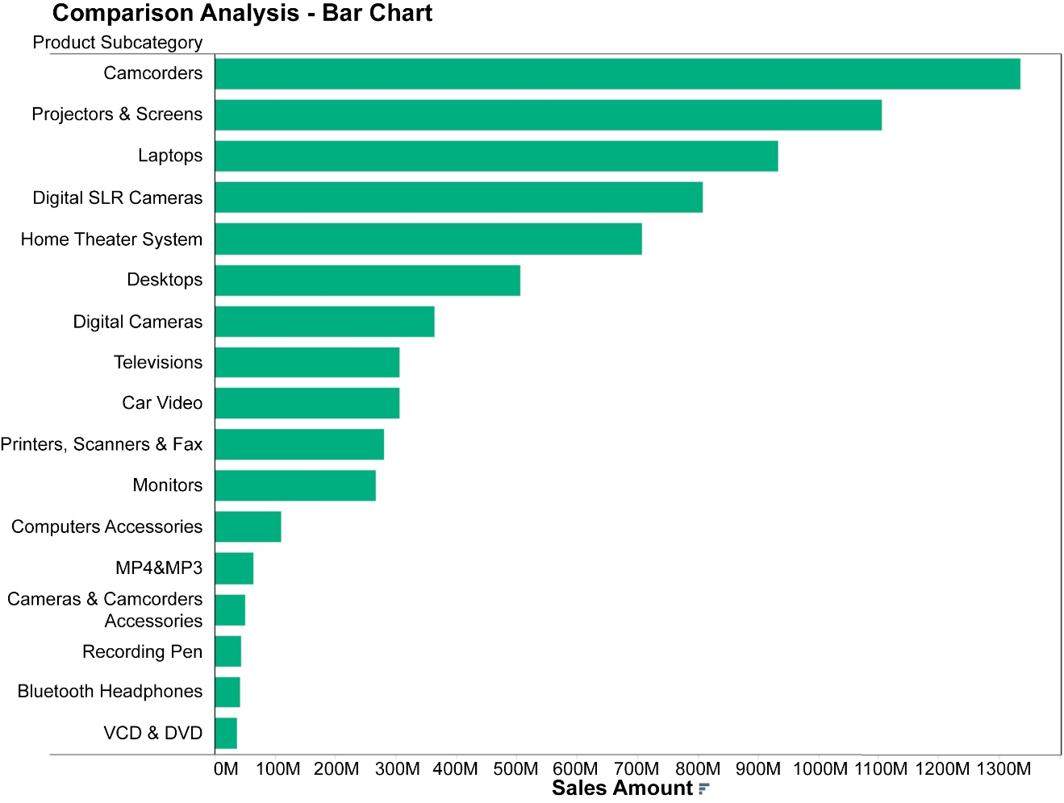
Comparison analysis – bar chart
f13-04

Slide 9
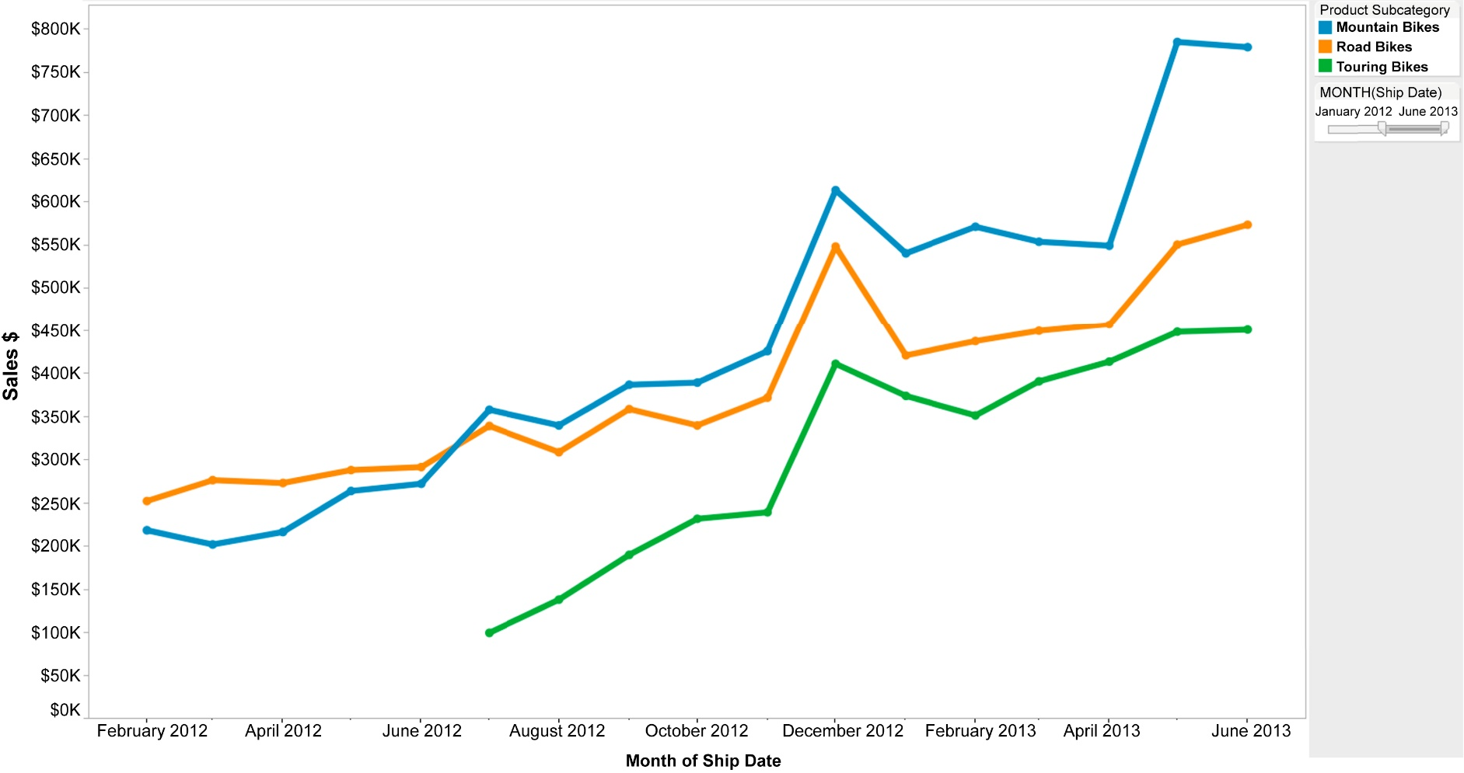
Trend analysis with line graph
f13-05

Slide 10
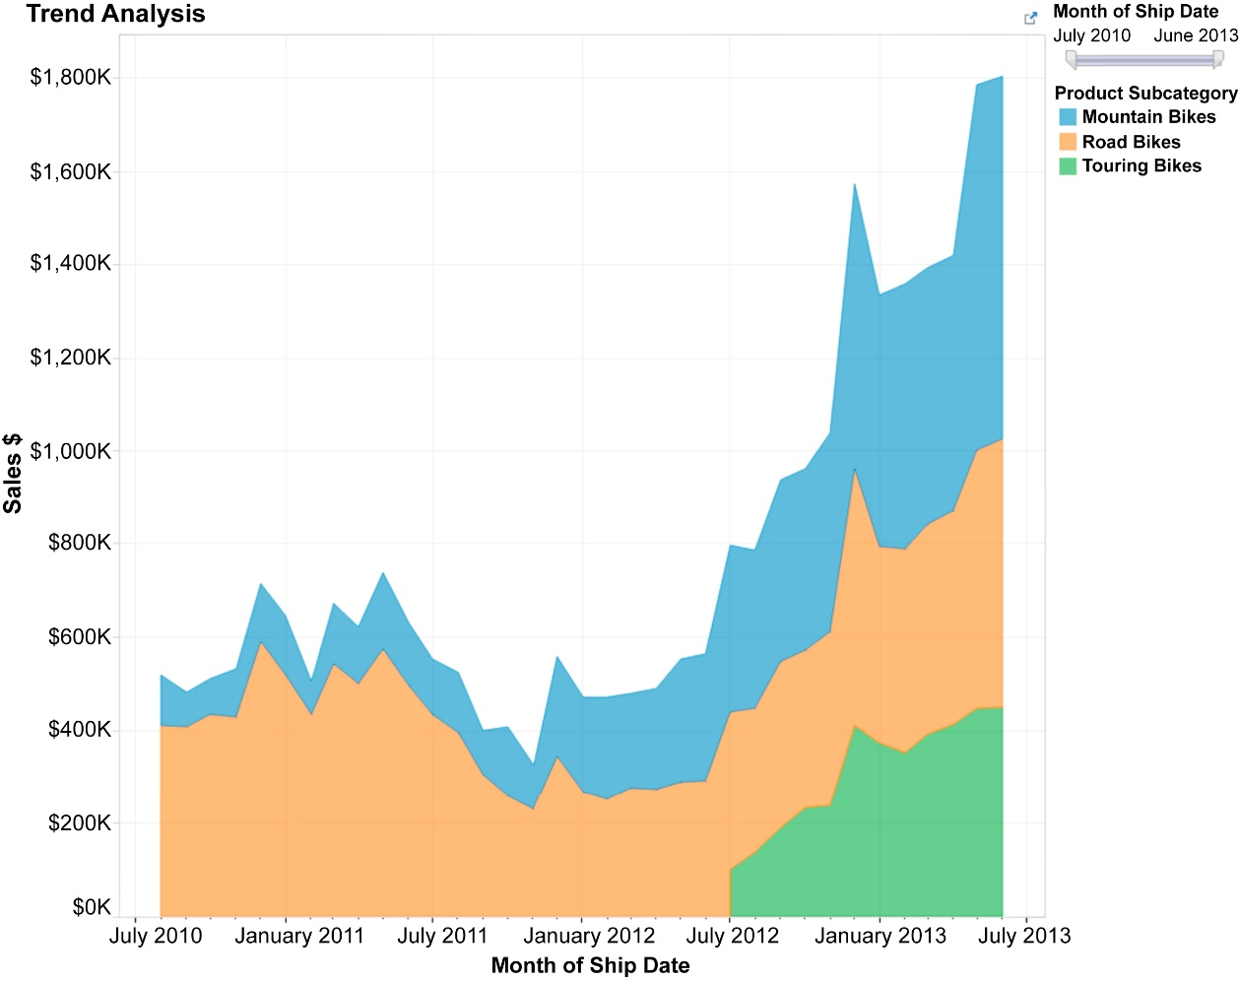
Trend analysis – area chart
f13-06

Slide 11
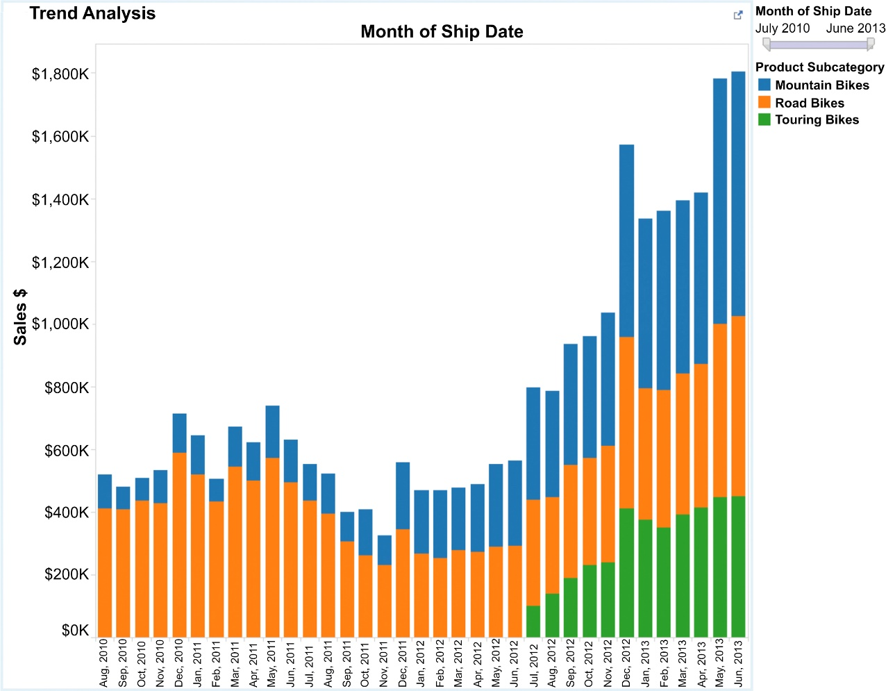
Trend analysis – bar chart
f13-07

Slide 12
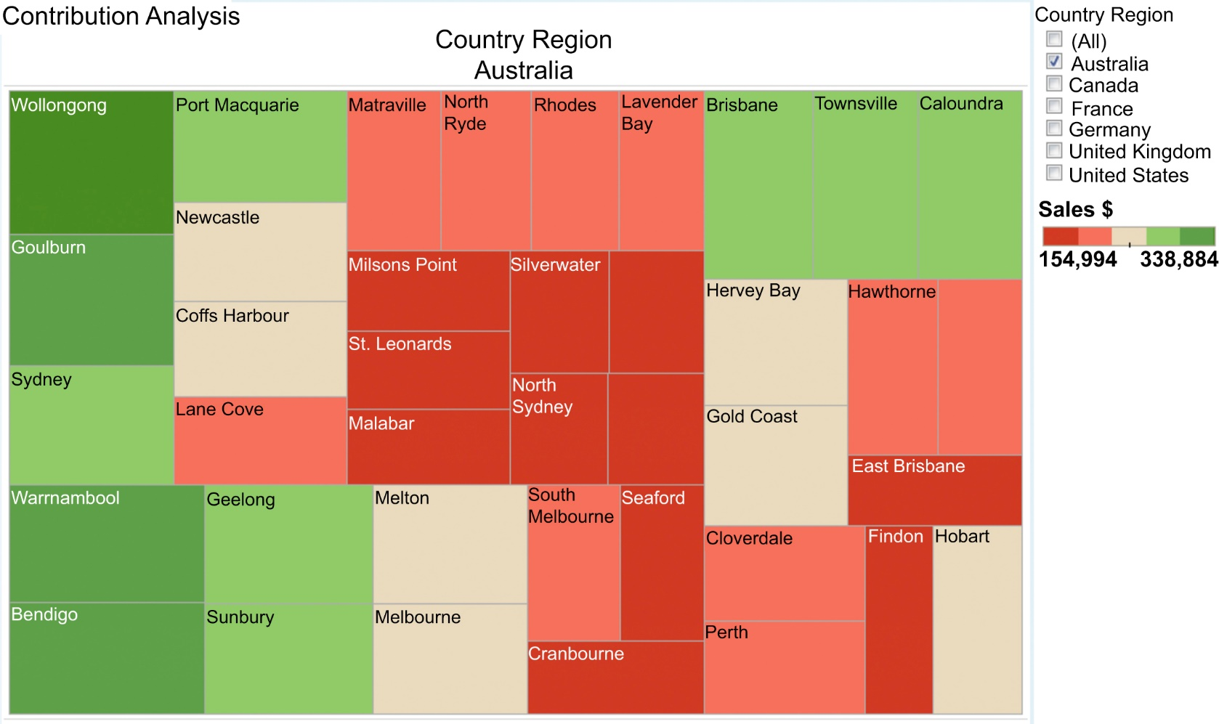
Contribution analysis – heat map
f13-08

Slide 13
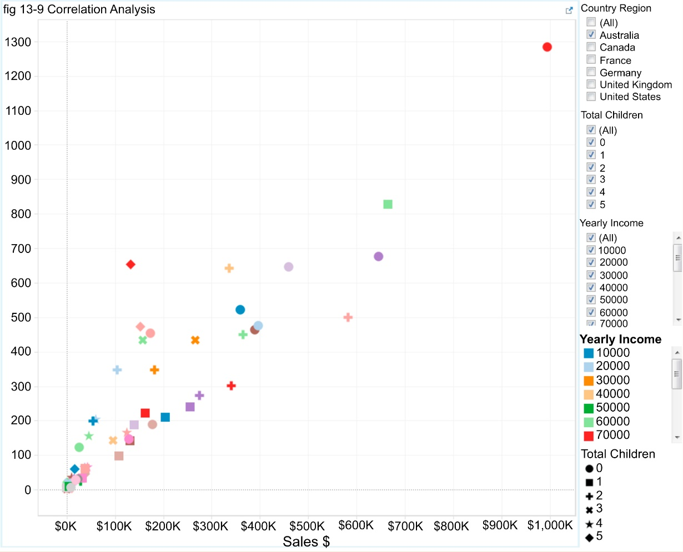
Correlation analysis – scatter plot
f13-09

Slide 14
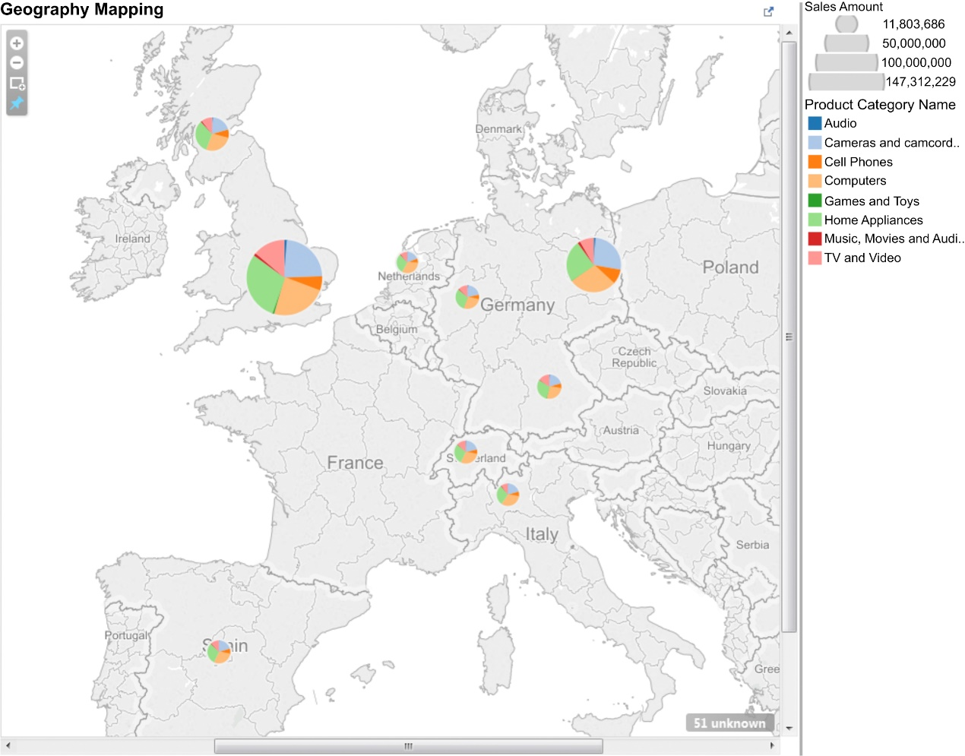
Geography mapping
f13-10

Slide 15
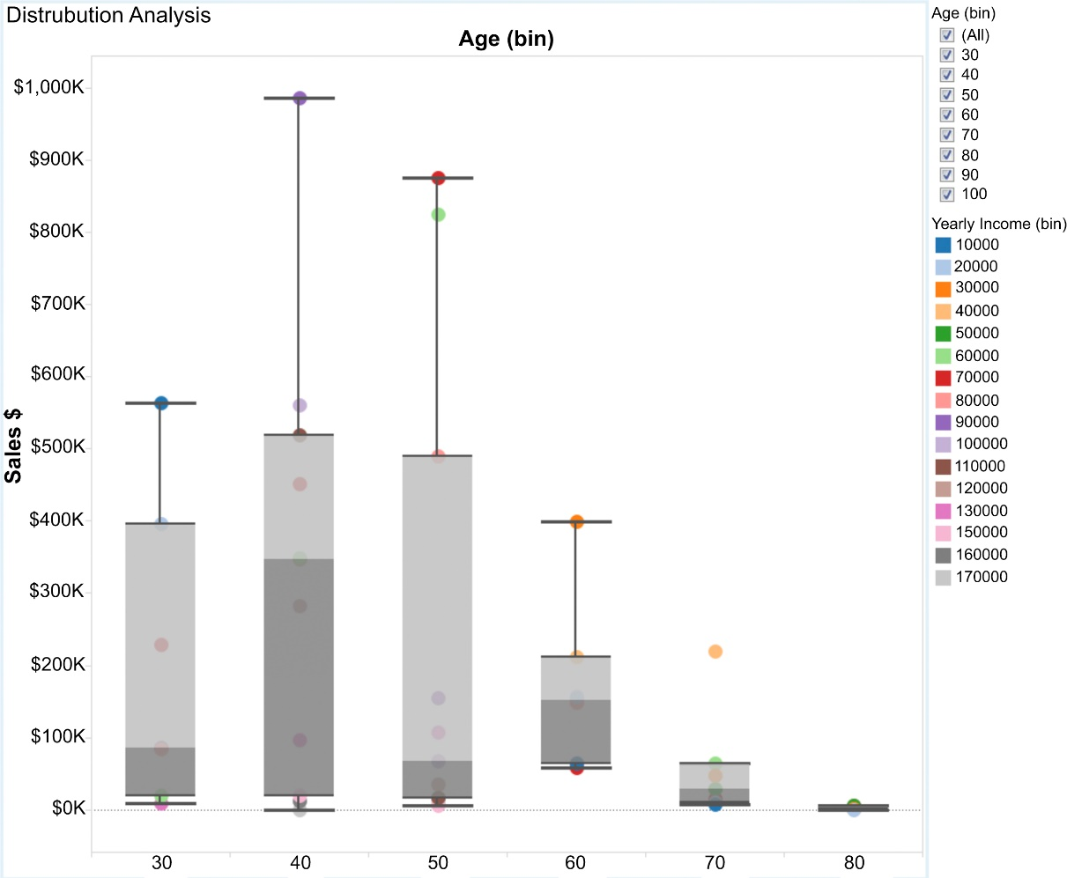
Distribution analysis – box plot
f13-11

Slide 16
Chapter 14 BI Design and Development

Slide 17

BI visual design methods
f14-01

Slide 18
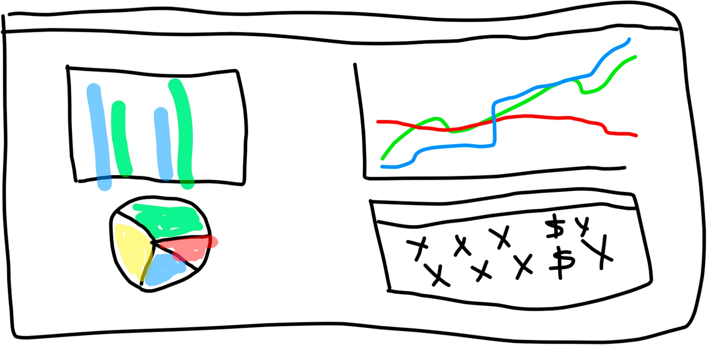
Whiteboard sketch
f14-02

Slide 19
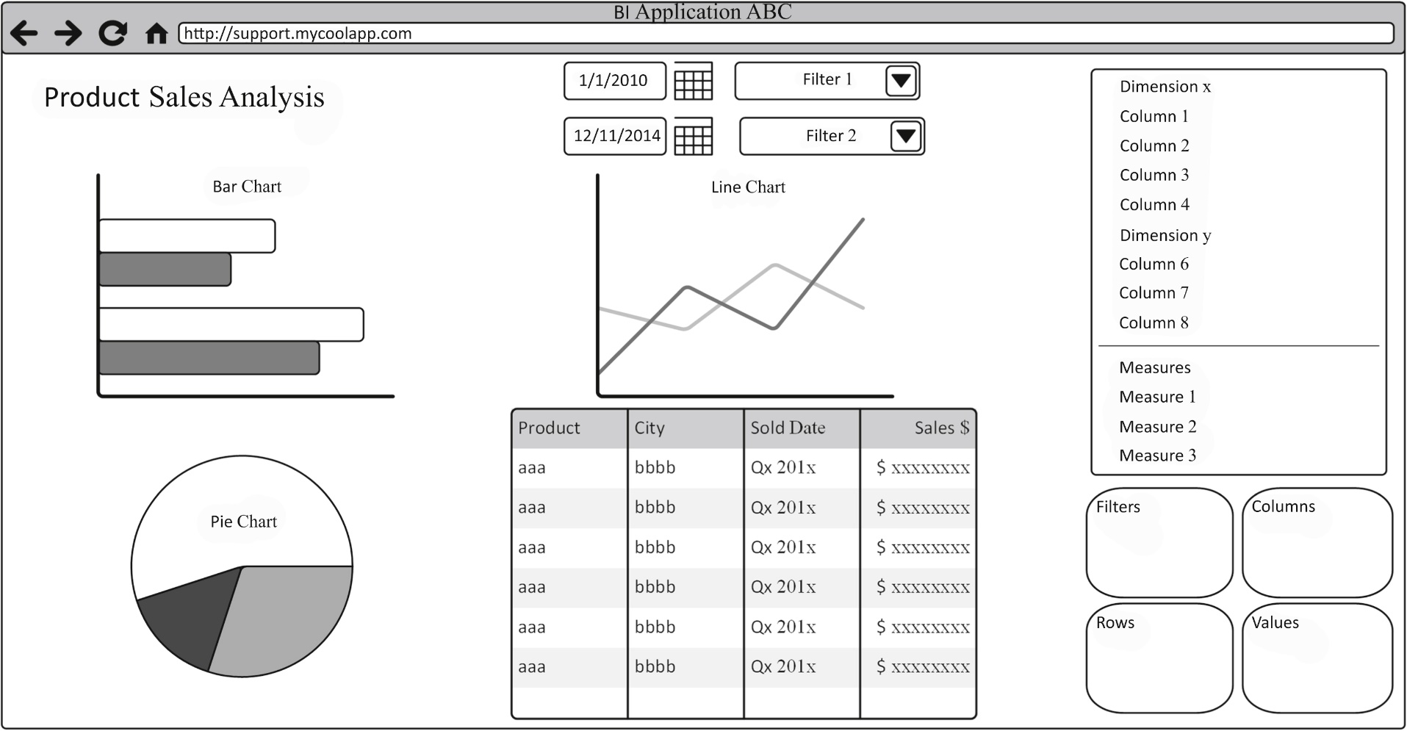
BI application wireframe
f14-03

Slide 20
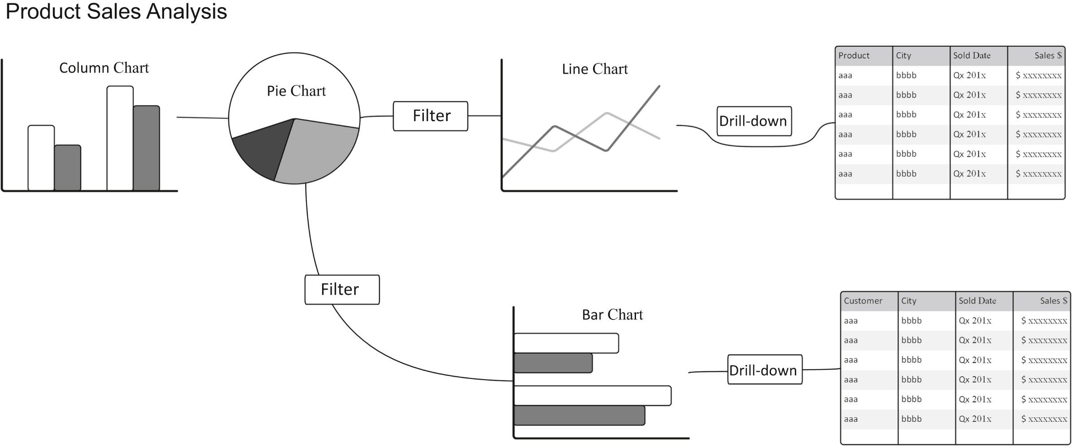
BI storyboard example
f14-04

Slide 21
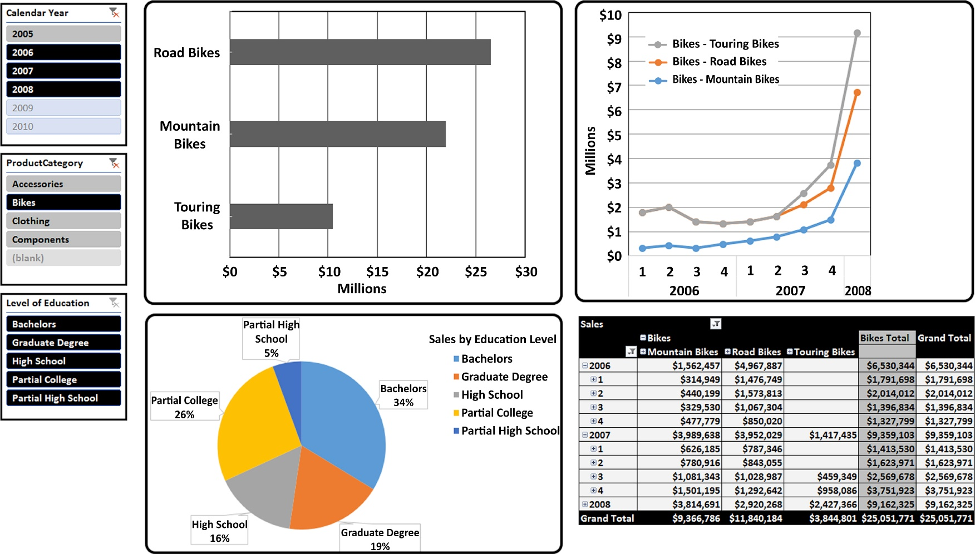
BI mockup example
f14-05

Slide 22
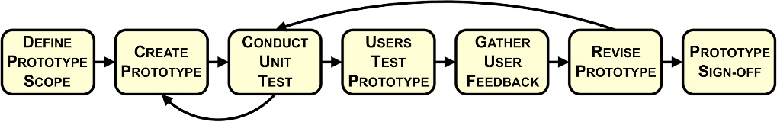
BI prototyping
f14-06

Slide 23
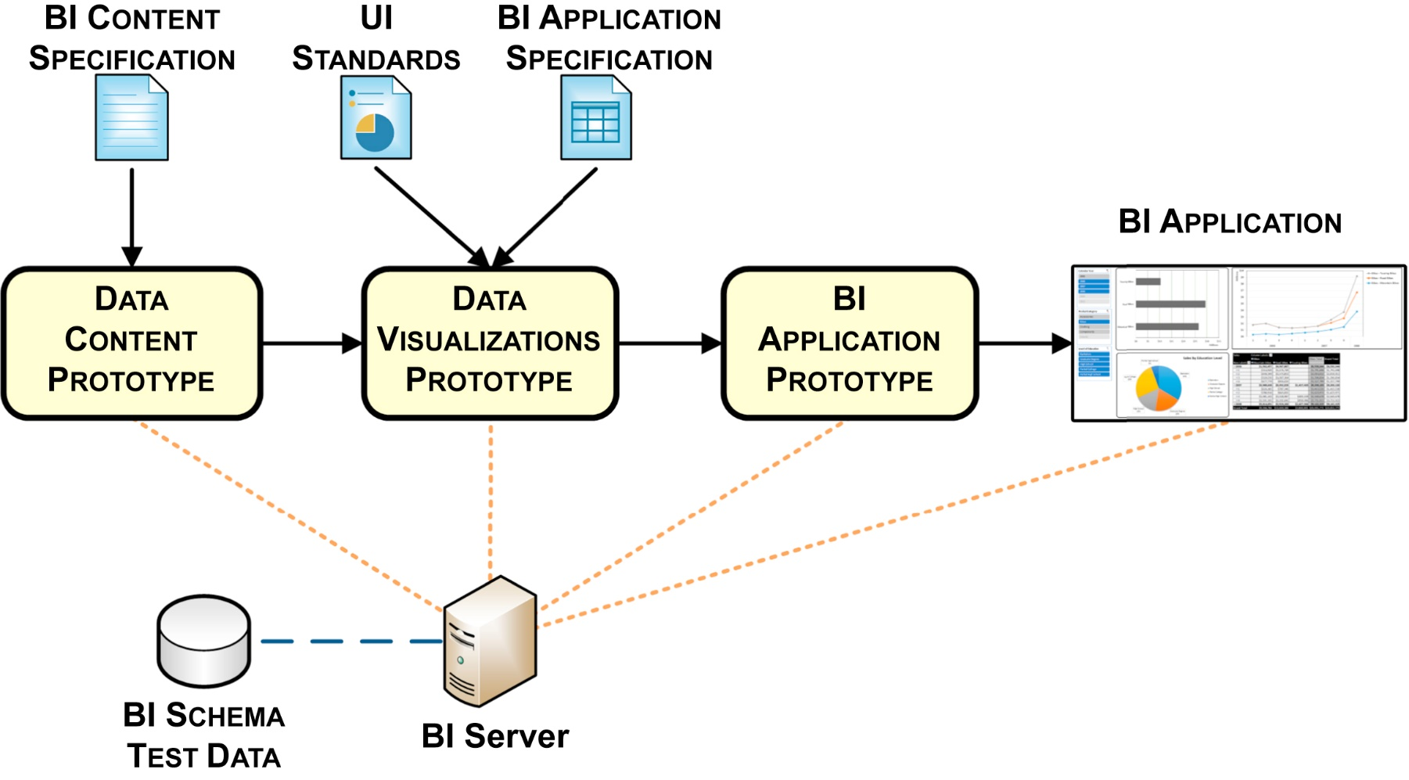
BI application development lifecycle
f14-07

Slide 24
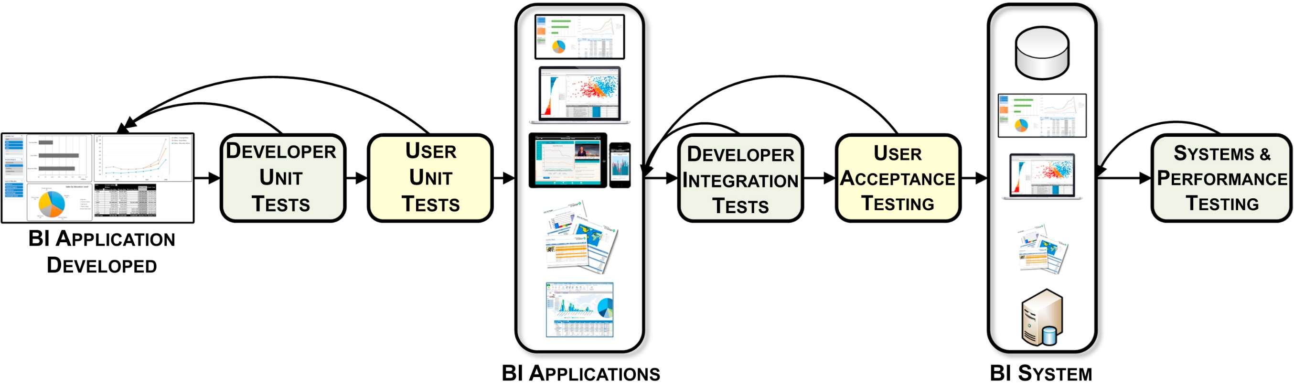
BI application testing
f14-08

